Slide 1

Blockchain in Sports
This report outlines the development and implementation of a blockchain-based sports event ticketing system and merchandise authentication known as "Project Tribal." The system leverages the Ethereum blockchain to provide secure, transparent, and verifiable ticketing solutions for sports events.
BELOW HERE SOME SCREENSHOTS AND SNAPSHOTS REGARDING THIS PROJECT:

Slide 2
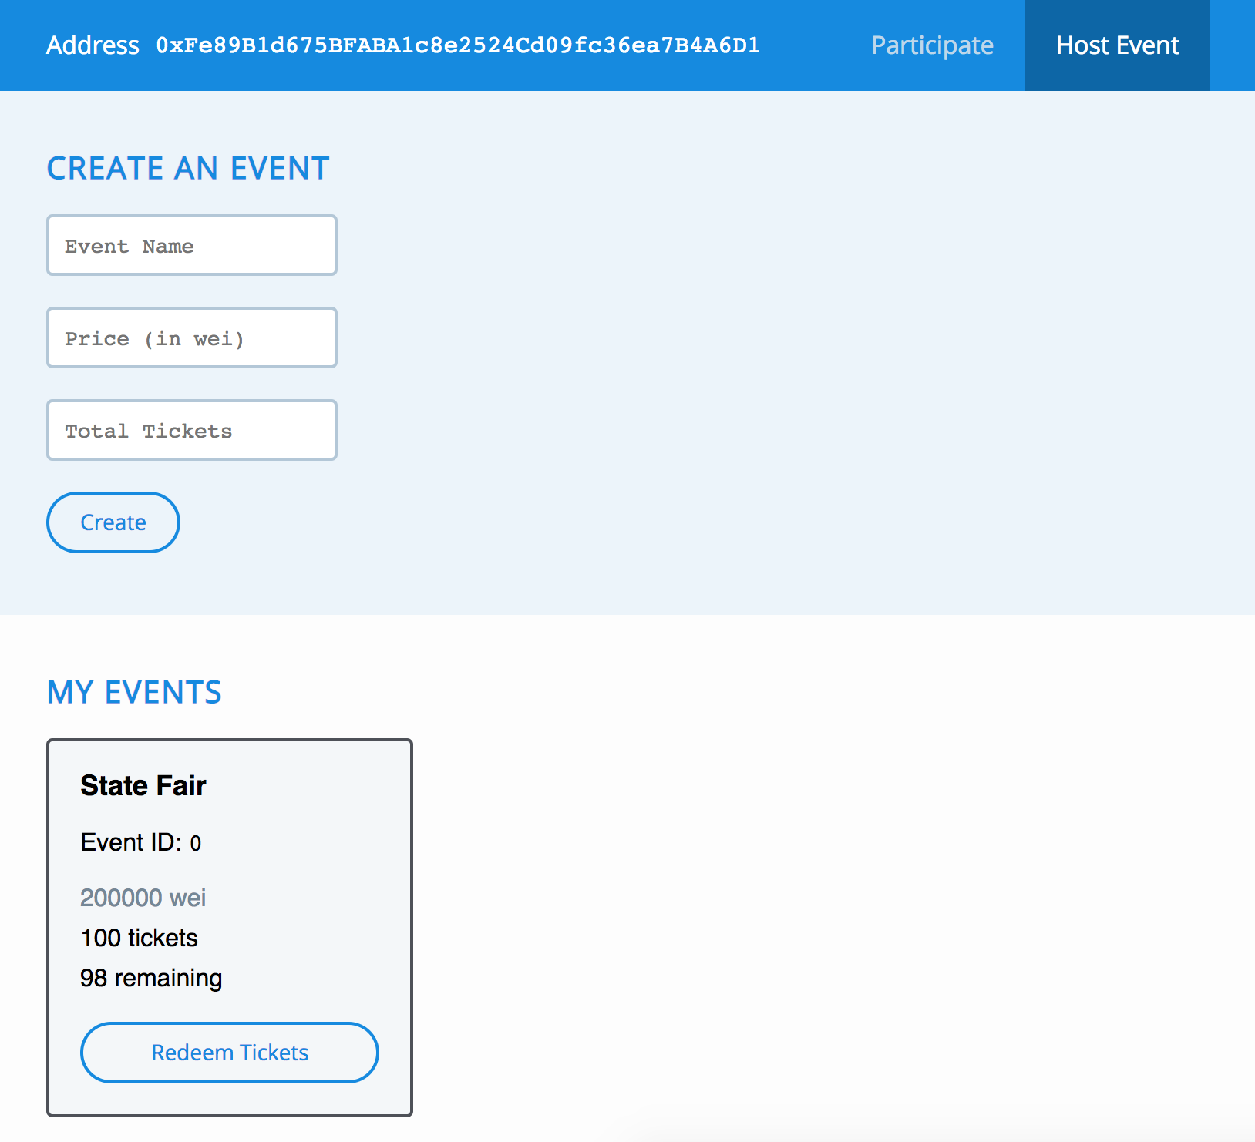

Slide 3
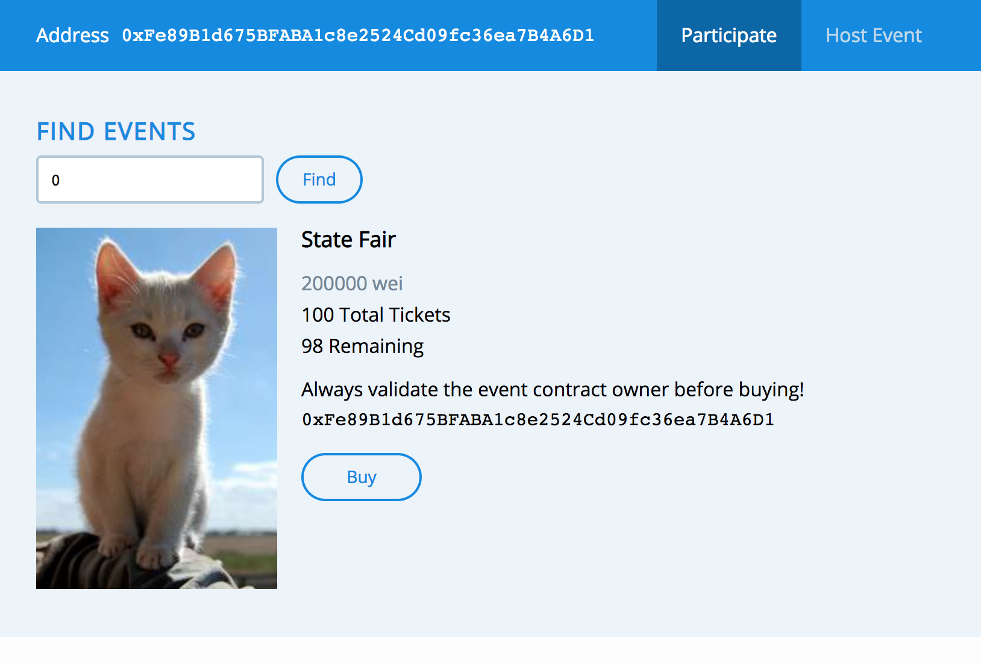

Slide 4
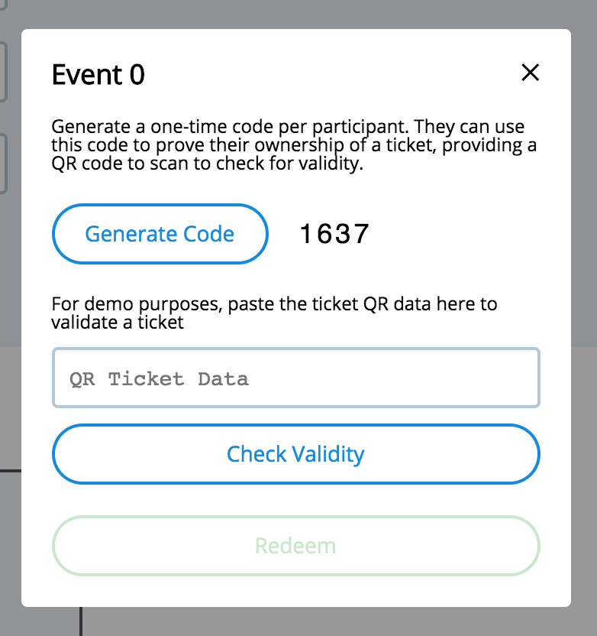
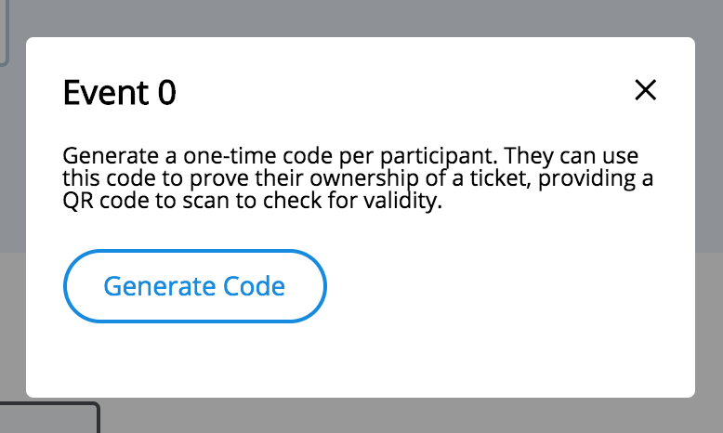

Slide 5
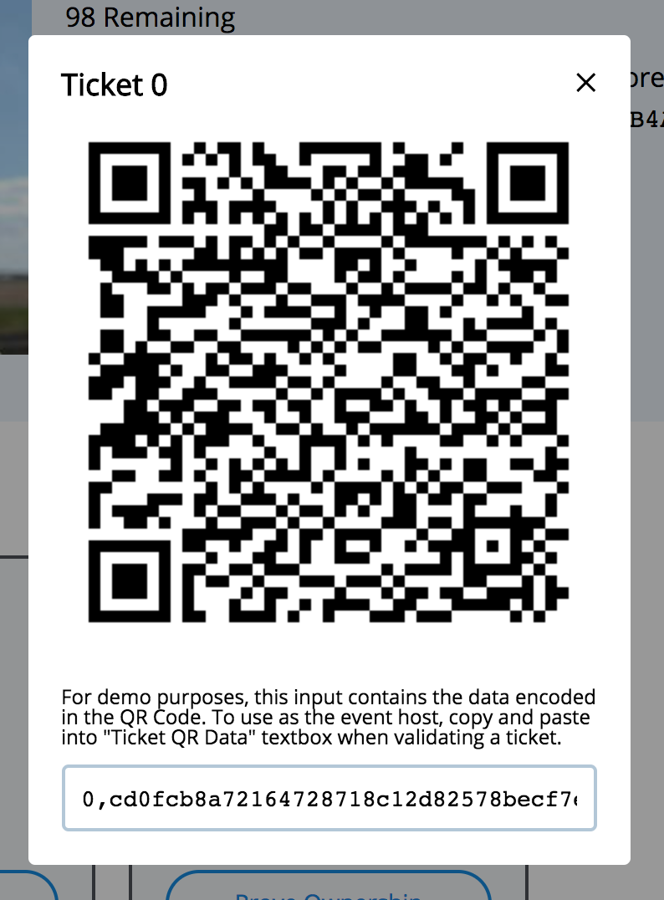
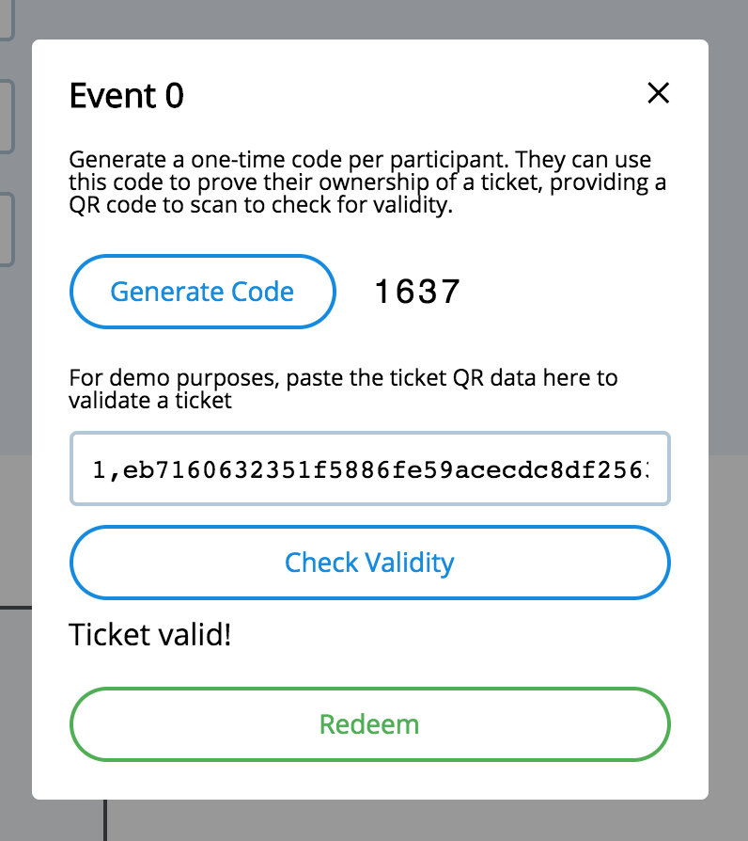
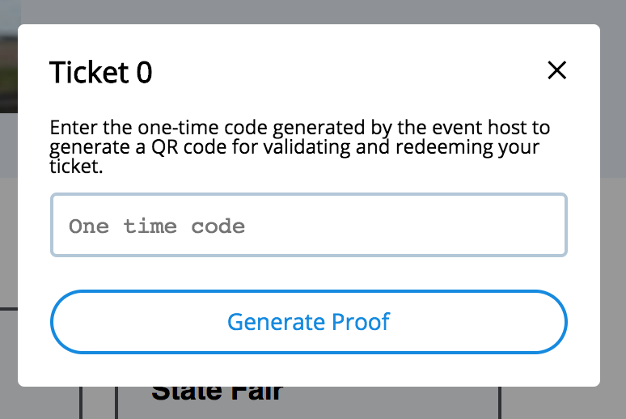

Slide 6
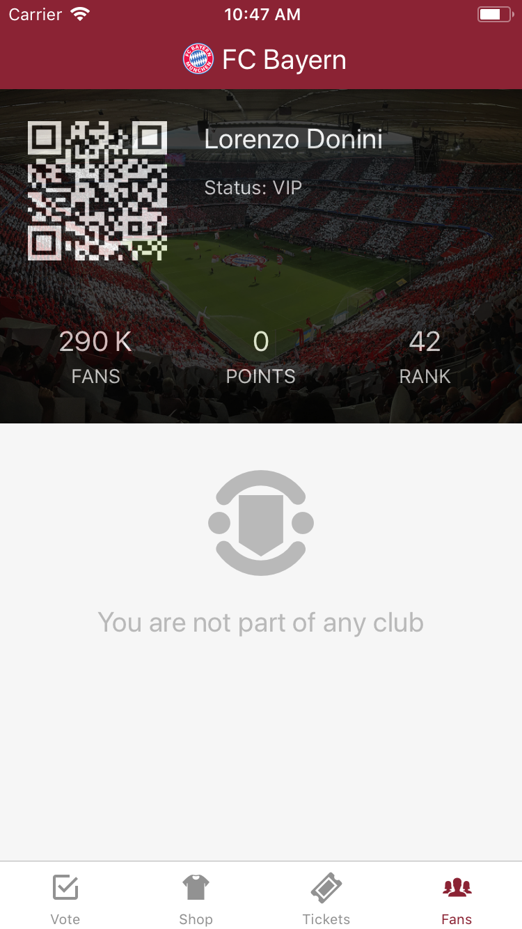
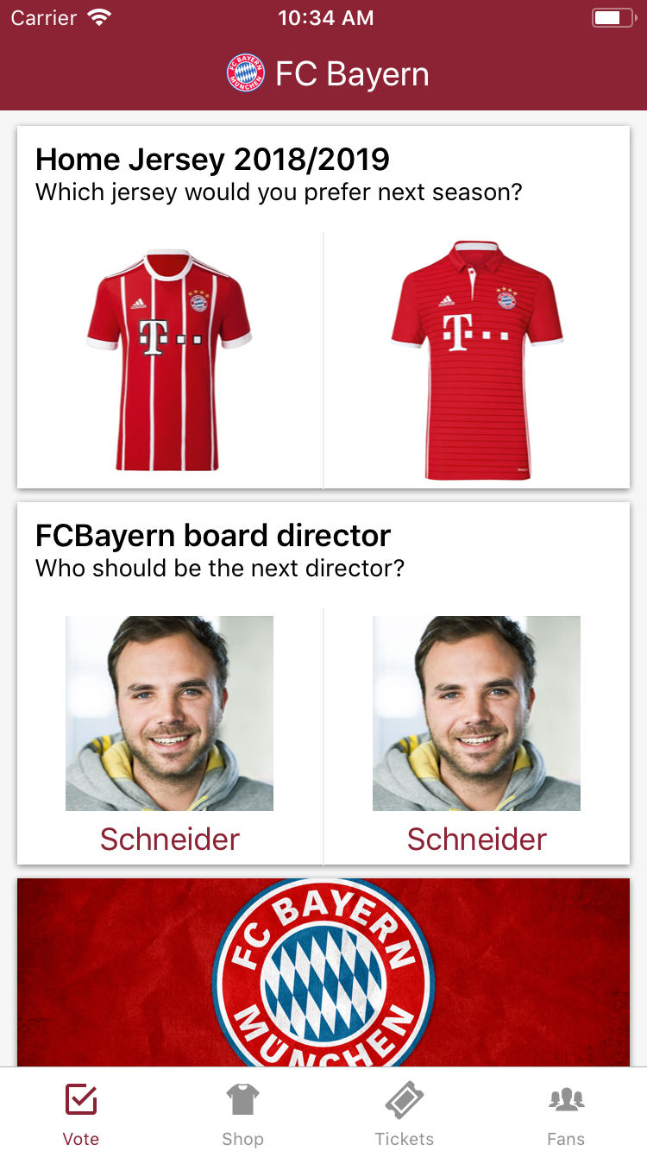

Slide 7
NAME : PRABHAT KAMTI
STREAM : CSE(AIML)
ENROLLMENT NUMBER : 12020002016008
YEAR : 4TH

